Slide 1
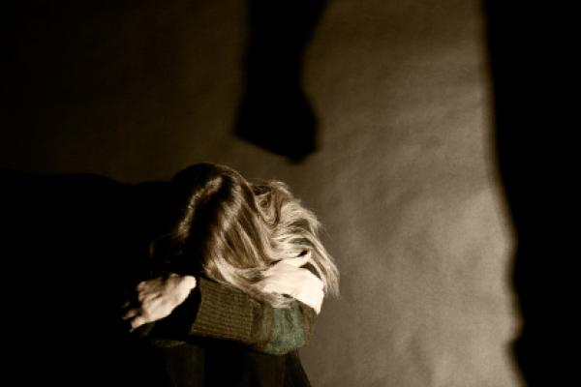
VIOLENCE AGAINST WOMEN
Presenter:
VIRGIBAL S. VALLO
MASTER TEACHER II

Slide 2
What is VAW?
It is any act of gender-based violence that results in or likely to result in physical, sexual or psychological harm or suffering to women, including threats of such acts, coercion or arbitrary deprivation of liberty whether occurring in public or private life.

Slide 3
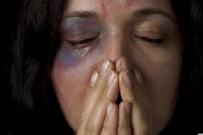
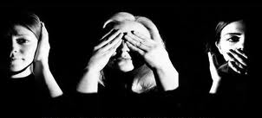

Slide 4
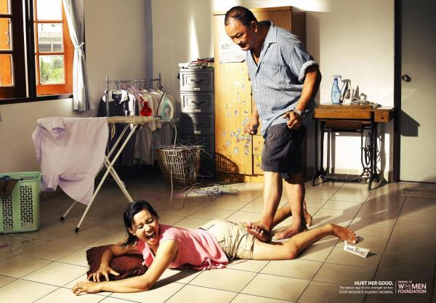
What are the Different Acts of Violence ?
1. PHYSICAL VIOLENCE
Acts that include bodily or physical harm

Slide 5
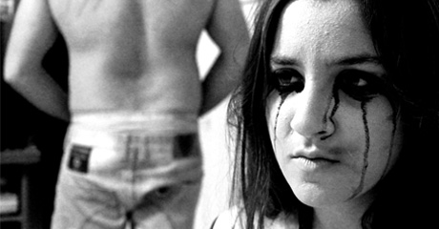
2. SEXUAL VIOLENCE
Acts which are sexual in nature

Slide 6
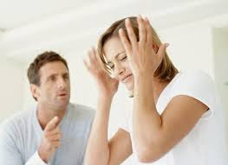
3. PSYCHOLOGICAL VIOLENCE
Commission or omission of acts which cause mental or emotional suffering of the victim

Slide 7
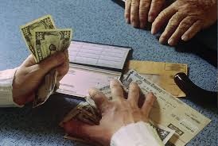
4. ECONOMIC ABUSE
Acts that make a woman financially dependent on the offender

Slide 8
Who are protected under the law?
The anti-VAWC Acts protect their women and their children, specifically
1. Wife or former wife of the offender
2. Woman with whom the offender has or had a dating or sexual relationships
3. the mother of the child of the offender
4. the child, whether legitimate or illegitimate of the woman

Slide 9
Who are punished by the law?
The following are liable:
Husband or former husbands
Any person with whom the victim has or had a sexual or dating relationships (e.g. boyfriends, live-in partners, or lesbian partners)
Any person with whom the victim has a common child
Father of the child-victim

Slide 10
What can a victim of violence do?
The victim can file any or all of the following:
1. Protection Orders
A. Barangay Protection Order (BPO)]
B. Temporary and Permanent Protection Order (PPO)
2. Independent Civil Action for Damages
3.Criminal Action for Violation of the Anti-VAWC Act

Slide 11
What are the Penalties for committing VAW?
If the courts have proven that the offender is guilty of the crime, he maybe imprisoned and will be obliged to pay P 100, 000.00 to P 300, 000.00 in damages. The length of imprisonment depends on the gravity of the crime.

Slide 12
Thank you for listening!
NANCY T. USON
SSHT-III, EsP Dept.

